Slide 1
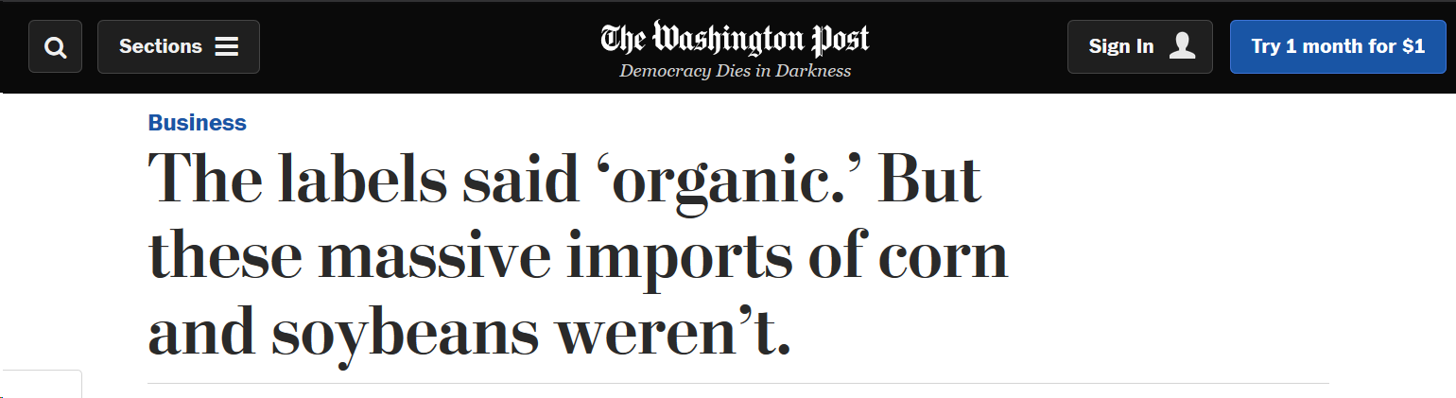

SoyChain - Trust in Global Supply Chains Challenge
David Baur
Remo Kellenberger
Pascal Küng
Julian Neff
Jasper Shi
Radek Zenkl

Slide 2
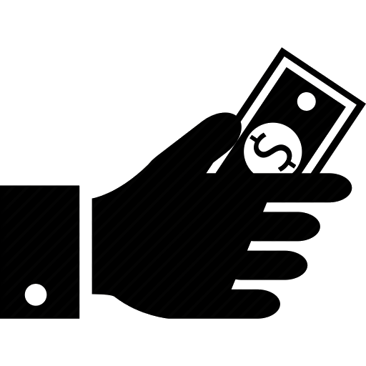

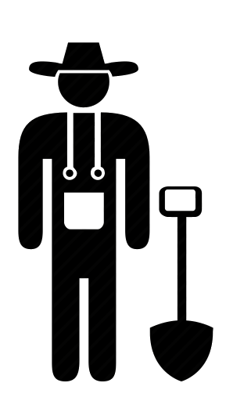
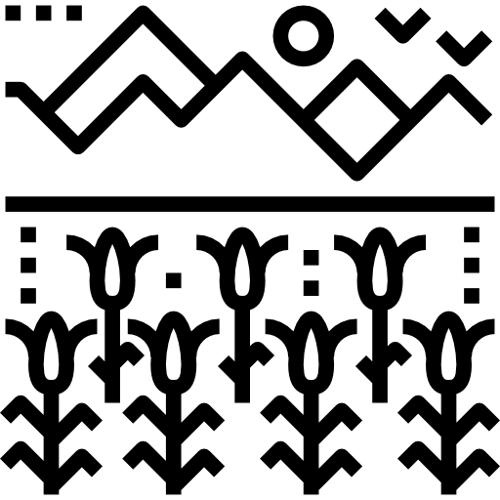
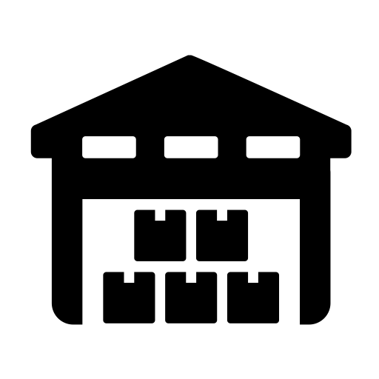
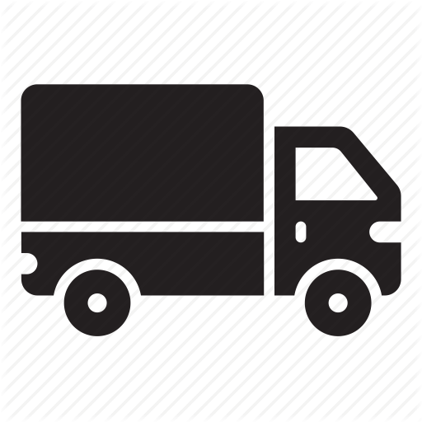
/**
* My commodity trading network
*/
namespace org.soychain.mynetwork
enum MovementStatus {
o HARVESTED
o IN_FARMERWAREHOUSE
o IN_TRANSITTRADER
o IN_TRADERWAREHOUSE
o IN_TRANSITBUYER
}
asset Soybean identified by soyId {
o String soyId
o String fieldId
o Integer quantity
o MovementStatus movementStatus
--> TradingPartner owner
}
asset Field identified by fieldId {
o String fieldId
o Integer limit
--> Farmer owner // maybe dont need
}
abstract participant TradingPartner identified by tradeID {
o String tradeID
--> Soybean[] soybeans
}
participant Trader extends TradingPartner {
}
participant Buyer extends TradingPartner {
}
participant Farmer extends TradingPartner {
o Boolean hasWarehouse
o Boolean hasTransportation
o Integer capacity
o Boolean useSubcontractor
}
transaction Trade {
--> Soybean soybean
--> TradingPartner newOwner
}
transaction Harvest{
o String name
--> Field field
--> Farmer owner
o Integer quantity
}
transaction Merge{
--> Soybean bean1
--> Soybean bean2
}
transaction Split{
--> Soybean bean1
o String bean2
o Integer quantity
}
/*transaction Trade {
--> Commodity commodity
--> Trader newOwner
}
event TradeNotification {
--> Commodity commodity
}
transaction RemoveHighQuantityCommodities {
}
event RemoveNotification {
--> Commodity commodity
}*/
Field A: 100 tons
Trader
Field B: 200 tons
Potential
Fraud
Potential
Fraud
Farm 3 (Non- certified)
Swiss Buyer
x 4
How can we ensure the buyer that the product he/she buys is certified?
Field A: 74 tons
Field B: 120 tons
Farm 1
(Certified)
Field C: 60 tons
x 2
Field A: 200 tons
Farm 2 (Certified)
Field B: 60 tons

Slide 3
Approach
Each harvest gets recorded on Hyperledger with the Amount, the Date, the Farmer ID and the Field ID
A Vol-Tech Scanner gets installed on each farm to measure each harvest
Washed/dried soybeans are packed into Big-Bags with tamper-proof QR-codes
Trucks are equipped with GPS-scanners to ensure the journey of the bags on Hyperledger Composer
QR-Codes provide information of the harvest and journey of the bags

Slide 4
Outcome
Social:
Customers can instantly track the certified soy-products’ complete supply chain journey
Customer can be insured about age, origin and journey of the product.
Economic:
No more “organic fraud” possible
Companies can provide proof for their product
Environmental:
Use of Scanners on farms in this scenario is not sustainable
Encouraging trust towards organic labels and thus increasing demand for sustainable food
Farmers might have to provide new energy supply for each warehouse

Slide 5
Difficulties
Negative Outcome
No way to sell undocumented harvest as certified → food-waste
Blockchain Technology might be too complicated for farmers
Small farmers might struggle maintaining the necessary scanners.
Unsolved questions
What happens if the technology fails?
Who pays for this solution?
Software Demo

